Slide 1
Sect 7.2 Problems Involving Lines, Circles, and Ellipses

Slide 2
Problems involving Lines, Circle, and Ellipses:
Most problems involved in this section are about finding intersection points between lines, circles, and ellipses
Suppose you are given two equations, use substitution or elimination to solve for “x” and “y” to get the points of intersections
A line can intersect at a circle at either:
One Point: TANGENT Line and Radius are perpendicular at intersection point [Discriminant = 0] OR use the “shortest distance formula”
Two POINTS: The two intersection points creates a chord, radius is a perpendicular bisector [Discriminant > 0]
NO points: System will not solve, No solutions [Discriminant < 0]
The radius is perpendicular to the tangent line!!
The radius is perpendicular to the chord and bisects it

Slide 3
II) Circles and Tangent Lines
Note: The radius is perpendicular to the Tangent Line at the point of tangency
Note: Two lines that are perpendicular have slopes that are “Negative Reciprocals” and multiply to -1.
Ie:
When finding tangents equations to a circle:
Horizontal Tangents: Find both the highest & lowest point of the circle
Vertical Tangents: Find points furthest to the right & left of the circle
Tangents (Slanted): Find the slope of the radius to the tangent point→ slope of the tangent line (negative reciprocal)

Slide 4
iii) Horizontal & Vertical Tangents
Ex: Given the equation of the circle of the vertical and horizontal tangents
Center:
Radius:
y
5
Vertical Tangents
4
3
2
1
x
Horizontal Tangents
-4
-3
-2
-1
0
1
2
3
4
-1
-2

Slide 5
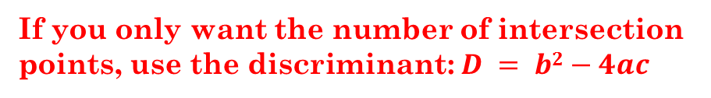
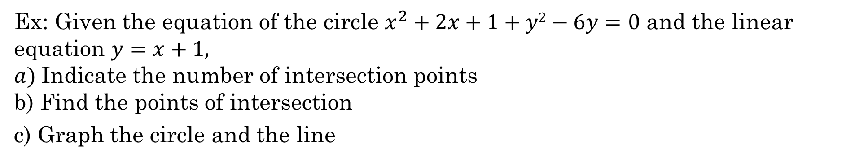
Ex: Given the equation of the circle $x^{2}+2x+1+y2−6y=0$ and the linear equation $y=x+1,$ $a)$Indicate the number of intersection points b) Find the points of intersection
c) Graph the circle and the line
To find the number of intersection points, substitute one equation into the other:
If you only want the number of intersection points, use the discriminant: $D = b2−4ac$
We have two points of intersection!!
The two points of intersection are (2,3) and (-1, 0)

Slide 6
Complete the square and convert the circle equation to standard form to make it easier to graph:
y
5
4
3
2
1
x
-4
-3
-2
-1
0
1
2
3
4
-1
-2

Slide 7
Practice: Find the points of intersections between the circles and lines. Graph the system of equation:

Slide 8
Ex: Solve the system:
Circle!
Use Substitution, replace “y” with “-x+4” in the circle equation
Line!
FOIL the brackets
Solve for “x” by factoring!
There are two solutions! The
X-coordinate for each point is: 2 and 5
Use the Line equation to solve for the Y-coordinates of each intersection point

Slide 9
y
3
2
1
x
-3
-2
-1
0
1
2
3
4
5
-1
-2
-3
-4
-5

Slide 10
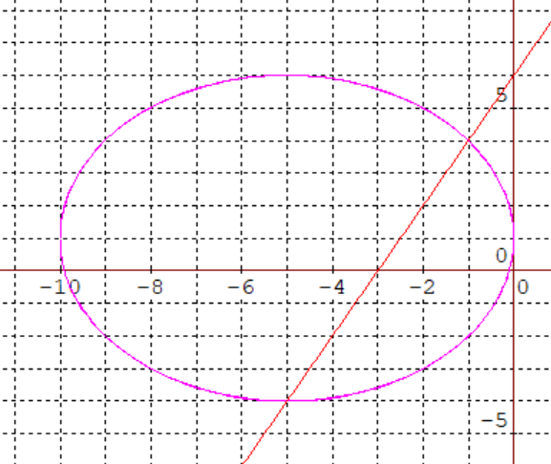
Practice: Find the points of intersections between the circles and lines. Graph the system of equation:
First convert the circle equation to standard form
Now substitute the line into the circle equation:
There are two answers for ‘x”, each one is for a separate intersection point between the circle and line
The intersection points are $(−5,−4)$ and $(−1,4)$

Slide 11
Practice: Find the points of intersections between the circles and lines. Graph the system of equation:
This is a system with two circles
Convert both circle equations into standard form

Slide 12
Finding Tangent Lines to a Circle:
A line that is tangent to a circle will only intersect it at one point
At the “Point of Tangency”, the radius and tangent line will be perpendicular to each other
If we have the “POINT” of Tangency, finding the equation line will be easy
RADIUS:
TANGENT LINE
The radius is perpendicular to the tangent line at the point of tangency!!

Slide 13
Ex: Find the Tangent Line to the circle at the point at the point (1,1)
Ex: Find the Tangent Line to the circle at the point (1,3)

Slide 14
Ex: Find the Tangent Line of at (1,1)
y
Find the slope of the radius Center to Tangent Point
5
4
3
Find the slope of the Tangent Line (Negative Reciprocals)
2
1
x
Find the equation of the Tangent Line (Line Equation)
-4
-3
-2
-1
0
1
2
3
4
-1
-2

Slide 15
Ex: Find the Tangent Line of at (1,3)
y
Find the slope of the radius Center to Tangent Point
5
4
3
2
Find the slope of the Tangent Line (Negative Reciprocals)
1
x
-7
-6
-5
-4
-3
-2
-1
0
1
2
3
4
5
-1
-2
Find the equation of the Tangent Line (Line Equation)
-3
-4
-5
-6

Slide 16
Shortest Distance Formula:
The shortest distance from a point to a line is a perpendicular distance towards the line:
So if we talk about the distance from a point to a line, it’s always referred to the shortest distance:
The shortest distance formula will give the distance from a point $(m,n)$ to a linear equation $Ax+By+C=0$
The shortest distance formula can be used to find the equation of a tangent line when we have the slope of the line along with the center and radius of a circle [with tangent point missing!!!]

Slide 17
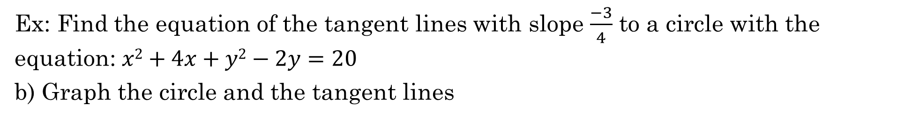
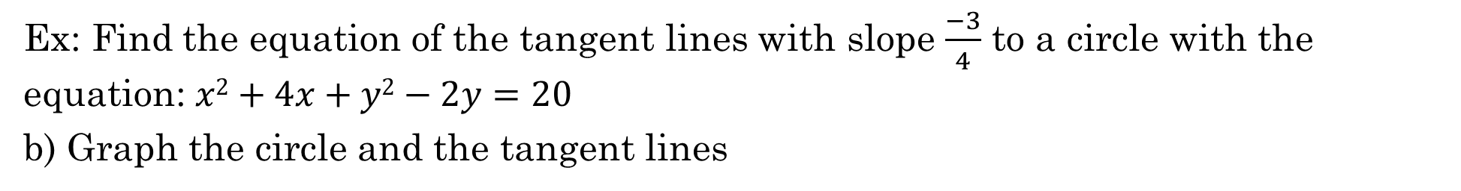
Ex: Find the equation of the Tangents to the circle with slope of
Ex: Find the equation of the tangent lines with slope $\frac{−3}{4}$ to a circle with the equation: $x2+4x+y2−2y=20$
b) Graph the circle and the tangent lines
Ex: Find the equation of the tangent lines with slope $\frac{−3}{4}$ to a circle with the equation: $x2+4x+y2−2y=20$
b) Graph the circle and the tangent lines
Ex) Find the Tangent Line to the circle: $x2+4x+y2+2y=20$ with a slope of $\frac{−2}{5}$. Graph the system of equation

Slide 18
Ex: Find the equation of the tangent lines with slope $\frac{−3}{4}$ to a circle with the equation: $x2+4x+y2−2y=20$
b) Graph the circle and the tangent lines
If we are to use the shortest distance formula, we would have:
First find the center and radius of the circle
Get the equation of the line in general form

Slide 19
Ex: Find the equation of the tangent lines with slope $\frac{−3}{4}$ to a circle with the equation: $x2+4x+y2−2y=20$
b) Graph the circle and the tangent lines
Since there is only one intersection point, the Discriminant should be equal to zero!!
We can also solve this equation using the Discriminant!!
This way, we don’t need to convert the equation to standard form!!
The equations of the tangent lines will be:

Slide 20
Ex: Find the equation of the Tangents to the circle with slope of
If the slope of the tangent line -3/4, the radius must be perpendicular to it
y
9
8
7
Tangent Line
Radius
6
Apply the slope of the radius to find the intersection points.
5
4
3
Note: There are 2 intersection points
2
1
x
-9
-8
-7
-6
-5
-4
-3
-2
-1
0
1
2
3
4
5
6
7
8
9
-1
-2
-3
-4
-5
-6
-7
-8
-9

Slide 21
iii) Find the Tangent Line to the circle: $x2+4x+y2+2y=20$ with a slope of $\frac{−2}{5}$. Graph the system of equation
This one is a little harder to solve graphically because the points of intersections are not integral points
Best way to solve this problem is to use the Shortest Distance Formula!!.....
So the equation of the two tangent lines will be:

Slide 22
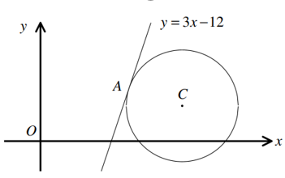
Ex: Given that the center of the circle is ($8,k)$what is the value of “k” if the line shown is a tangent?
Ex: Given the equation $x^{2}+y^{2}−10x−8y+21=0 ,$explain how you would show that the line $y=2x+4$ is tangent to the circle?

Slide 23
Ex: Given that the center of the circle is ($8,k)$what is the value of “k” if the line shown is a tangent?

Slide 24
Ex: Given the equation $x^{2}+y^{2}−10x−8y+21=0 ,$explain how you would show that the line $y=2x+4$ is tangent to the circle?

Slide 25
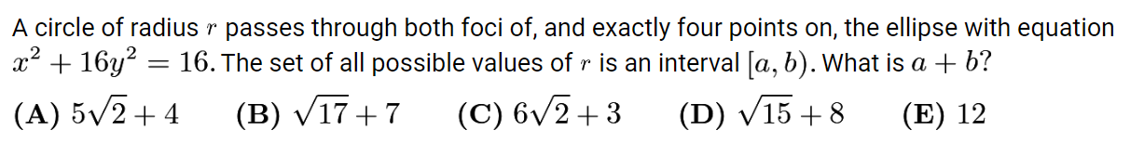
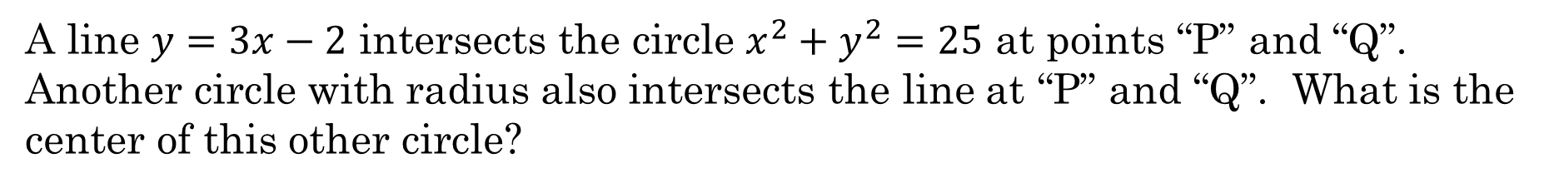
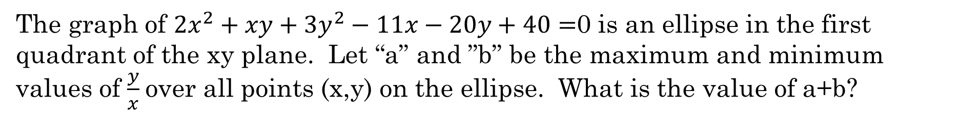
The graph of ${2x}^{2}+xy+3y^{2}−11x−20y+40=$0 is an ellipse in the first quadrant of the xy plane. Let “a” and ”b” be the maximum and minimum values of $\frac{y}{x}$over all points (x,y) on the ellipse. What is the value of a+b?
A line $y=3x−2$ intersects the circle $x^{2}+y^{2}=25$ at points “P” and “Q”. Another circle with radius also intersects the line at “P” and “Q”. What is the center of this other circle?

Slide 26
Graph the ellipse, find the coordinates of the foci.
The smallest circle should be centered at the center of the ellipse with a radii that is equal to the focus.
The maximum circle is a bit harder to find b/c the center is somewhere else…….

Slide 27
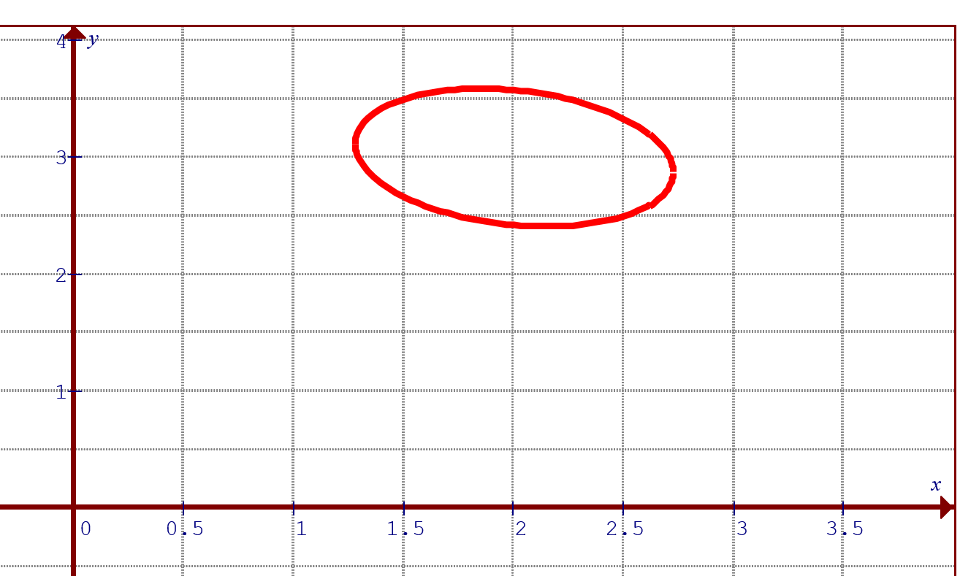
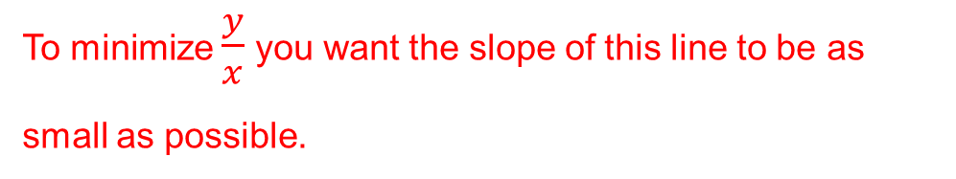
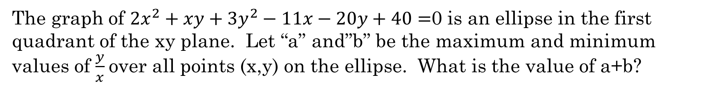
The graph of ${2x}^{2}+xy+3y^{2}−11x−20y+40=$0 is an ellipse in the first quadrant of the xy plane. Let “a” and”b” be the maximum and minimum values of $\frac{y}{x}$over all points (x,y) on the ellipse. What is the value of a+b?
If you take the time to graph out the equation, you get a slanted ellipse in the first quadrant, that look like this:
We can’t use the shortest distance formula b/c it is not a circle……
Suppose you draw a line from the origin to the ellipse, the slope of this line represents $\frac{y}{x}$
We can’t use calculus, b/c Chang won’t allow it……
To maximize $\frac{y}{x}$ you want this line to be as steep as possible and still intersect the ellipse
Graphing is too hard…….
To minimize $\frac{y}{x}$ you want the slope of this line to be as small as possible.
This leaves us with one option….. DISCRIMINANT!!!!
There’s only one intersection point, so the discriminant is equal to zero!!!!
To find both of these two values, we are looking for lines that intersect the ellipse at ONLY ONE POINT!!!!
Both of these two lines are TANGENT to the circle, it has only ONE point of intersection….. Which method should we use??????

Slide 28
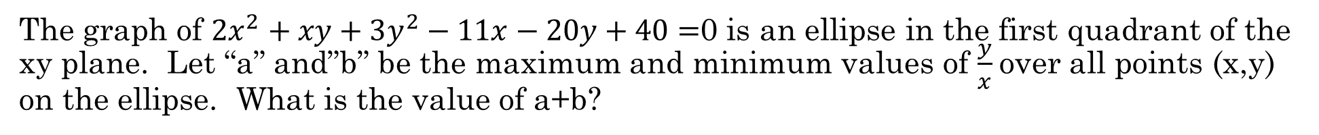
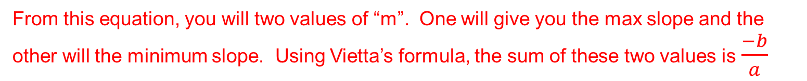
The graph of ${2x}^{2}+xy+3y^{2}−11x−20y+40=$0 is an ellipse in the first quadrant of the xy plane. Let “a” and”b” be the maximum and minimum values of $\frac{y}{x}$over all points (x,y) on the ellipse. What is the value of a+b?
Since the tangent lines start from the origin, the equations are in the form of $y=mx$
Substitute this into the original equation:
Discriminant Equation:
From this equation, you will two values of “m”. One will give you the max slope and the other will the minimum slope. Using Vietta’s formula, the sum of these two values is $\frac{−b}{a}$

Slide 29
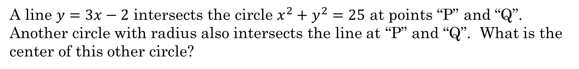
A line $y=3x−2$ intersects the circle $x^{2}+y^{2}=25$ at points “P” and “Q”. Another circle with radius also intersects the line at “P” and “Q”. What is the center of this other circle?

